Slide 1
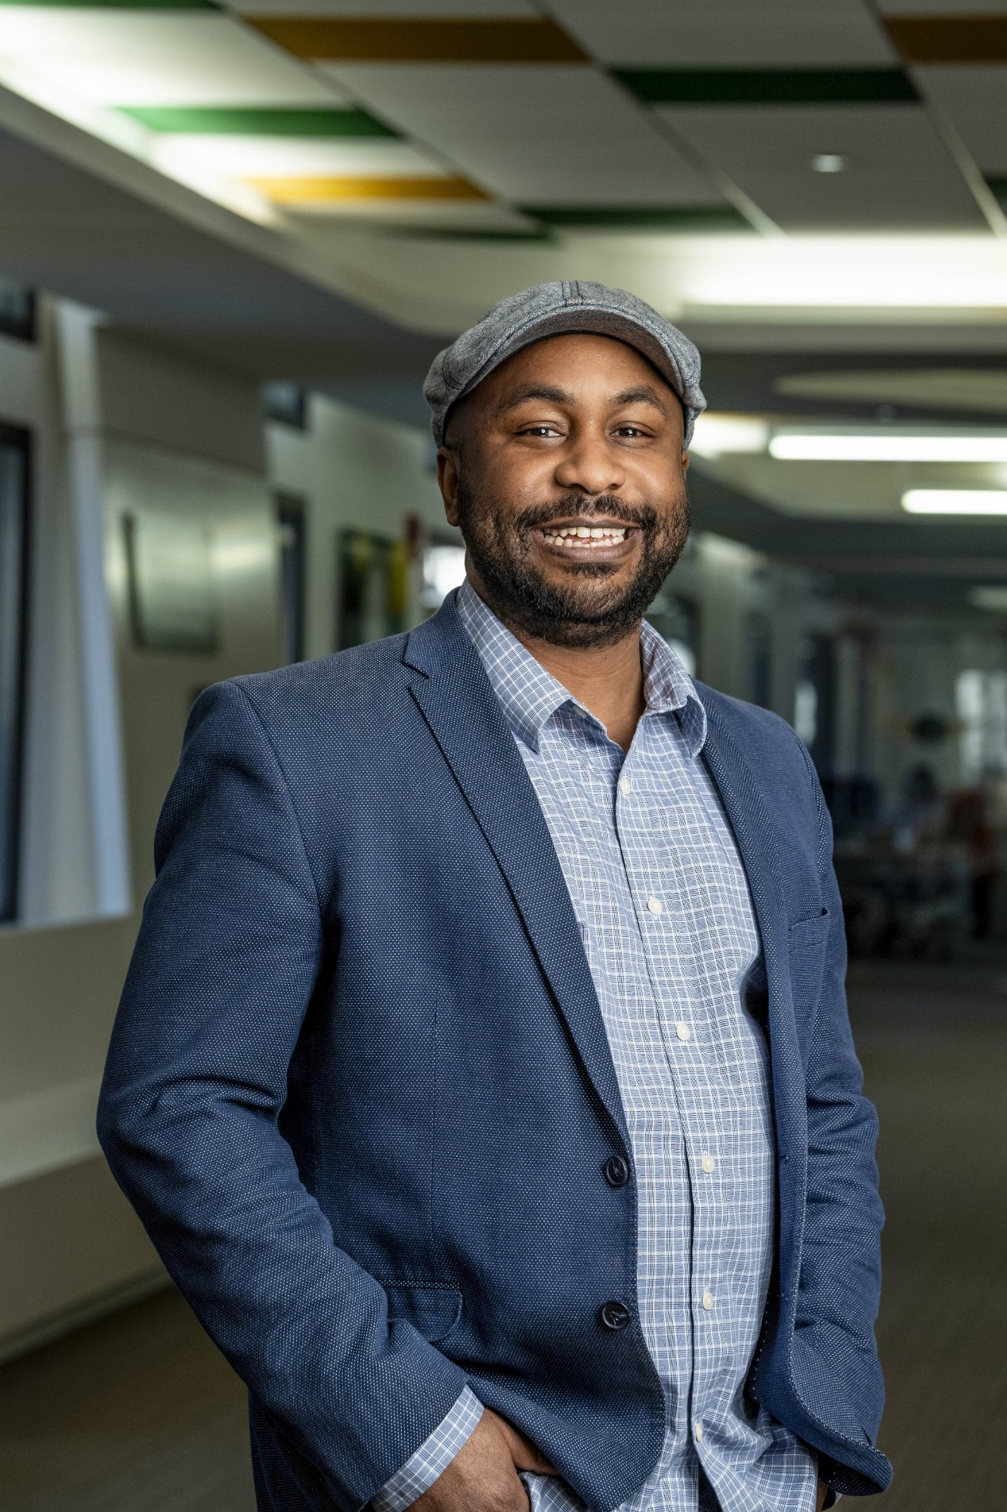



OL 3020 – Leadership Foundations | Wright State University
Influential
Leader
Dr. Emanuel O. Clayton, Ph.D.
Assistant Director – Academic Success
Student Success Center, Wright State University
Math Learning Center – Tutor Supervisor
Met: Summer 2024
Working: Spring 2025
Utsav Acharya | March 12, 2026
1 / 4

Slide 2

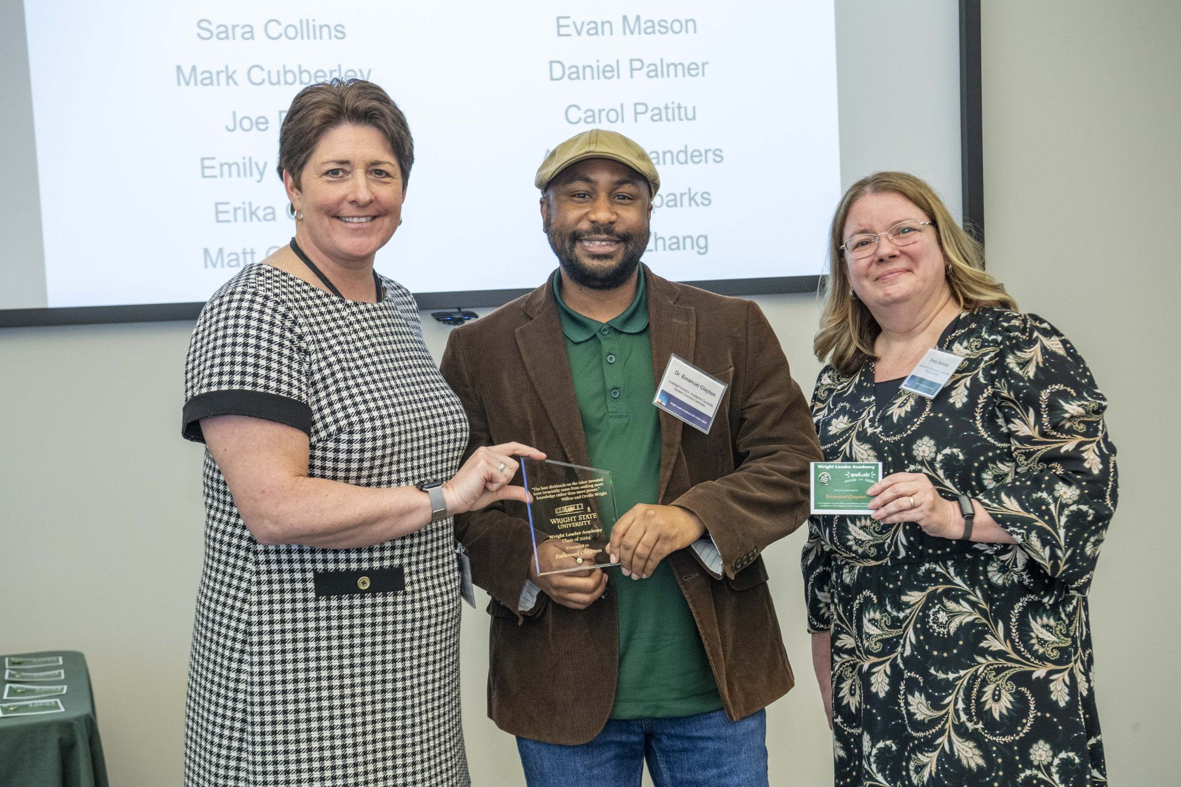

LEADERSHIP STRENGTH – GALLUP CLIFTONSTRENGTHS
Developer
Rath, T. (2007). StrengthsFinder 2.0. Gallup Press.
DEFINITION
Developers recognize and cultivate the potential in others. They notice small signs of growth and find genuine satisfaction in helping people improve (Rath, 2007).
Hires Strategically
Trains for Growth
Models Encouragement
Selects tutors who are knowledgeable, patient, and supportive.
Trains tutors for in-person and online sessions to build professional skills.
Responds to student mistakes with a smile and motivation, not discouragement.
Dr. Clayton receiving the Wright Leader Academy Award
Utsav Acharya | OL 3020 | Wright State University
2 / 4

Slide 3

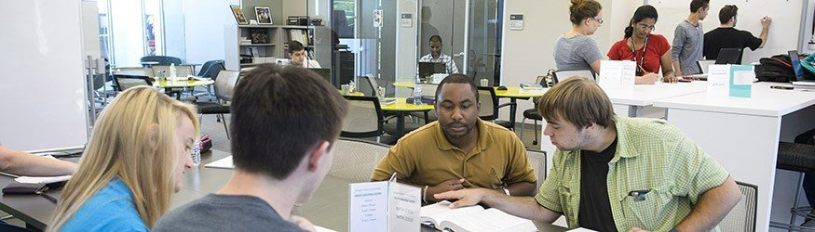
VISION IN PRACTICE – CHAPTER 7
Implements a Vision
Northouse, P. G. (2025). Ch. 7
THE VISION
Build student independence in mathematics — strengthen foundational skills so students no longer rely on others for answers.
01
02
03
Hire Right
Train & Prepare
Guide to Independence
Selects tutors with knowledge and patience to guide struggling students.
Trains tutors for online and in-person sessions, building professional skills.
Tutors walk students through thinking, not just giving answers.
Tutoring session at the Math Learning Center, Wright State University
Utsav Acharya | OL 3020 | Wright State University
3 / 4

Slide 4
References
Northouse, P. G. (2025). Introduction to leadership: Concepts and practice (6th ed.). Sage Publications.
Textbook
Rath, T. (2007). StrengthsFinder 2.0. Gallup Press.
CliftonStrengths
Clayton, E. O. (2026). Wright State University profile. https://people.wright.edu/emanuel.clayton
Leader Profile
Utsav Acharya | OL 3020 – Leadership Foundations | Wright State University | March 12, 2026

